Slide 1

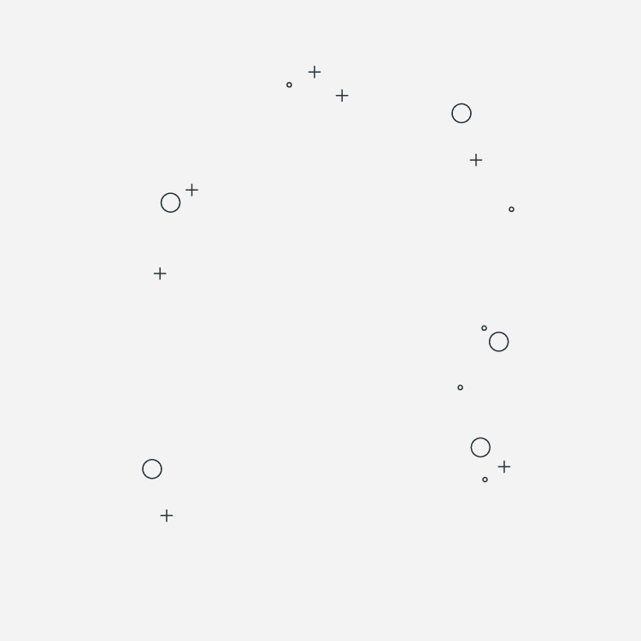
Naive Bayes & Simple Neural Network Classifier
Binary Classification
Citrus Dataset

Slide 2
01. ABOUT THE PROJECT
04. CONDIATIONAL DISTRIBUTION
05. NAÏVE BAYES CLASSIFIER
02. DATA EXPLORATION & CLEANING
03. HYPOTHESIS TESTING
06. SIMPLE NN CLASSIFIER

Slide 3

01
ABOUT THE PROJECT

Slide 4

This presentation aims at exploring and cleaning data as part of a comprehensive
analysis of two popular machine learning algorithms, the Naive Bayes (NB)
classifier, and Neural Network, for binary classification tasks.

Slide 5

02
DATA EXPLORATOIN & CLEANING

Slide 6
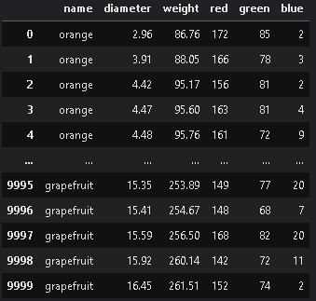
Importing & cleaning
Data being stored in form of csv file. So, Using the “Pandas” library to import it as a DataFrame.
Applying pd.read_csv(“path”)
The path is obtained from either the website (preloaded) or from the device we working on
To view the data just print the DataFrame.

Slide 7
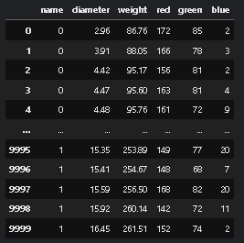
Categorical columns
To implement the classifier , columns need to be numerical even the categorical ones
So, after viewing the data at the beginning, the “name” column is categorical and non-numerical
DataFrame is flexible so this won’t be an issue, just subset the name column and map its values.
Orange 🡪 0 , Grapefruit 🡪 1
Data after adjusting name column

Slide 8
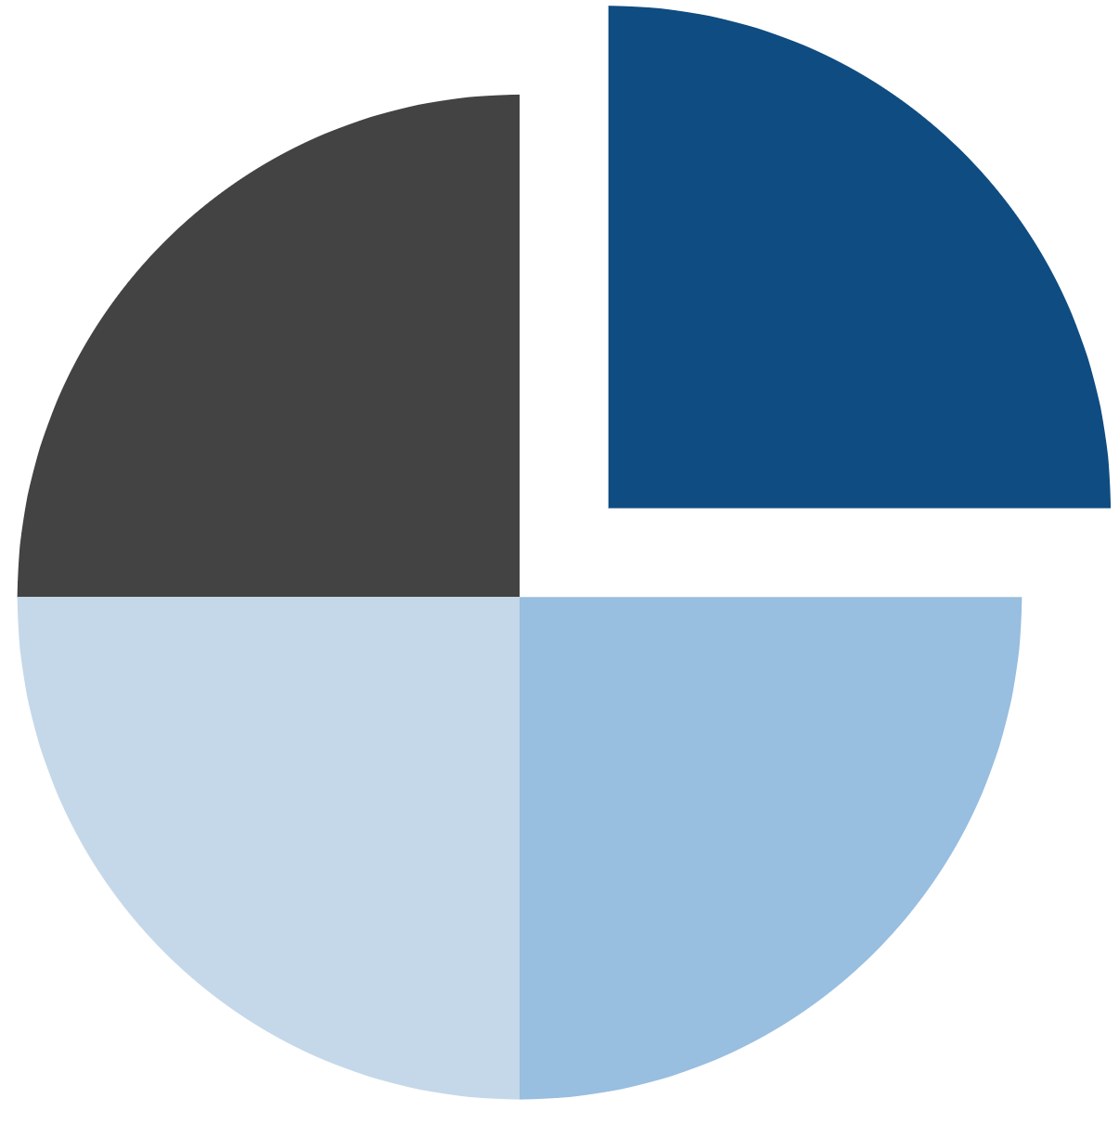
For cleaning
Remove Duplicate rows
drop_duplicates method
Remove the Outliers
(IQR method)
Remove rows
containing NaN values using Dropna method
Check for any wrong format values

Slide 9

NOW
We head to visualizing data after being cleaned
Using Seaborn library, we utilized the histplot() function to see the frequency of the values.

Slide 10
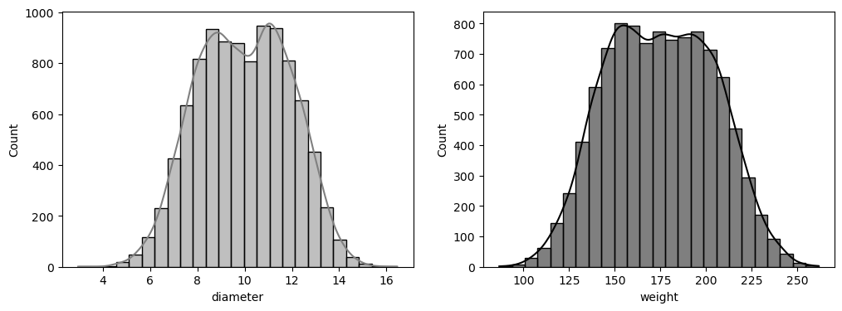
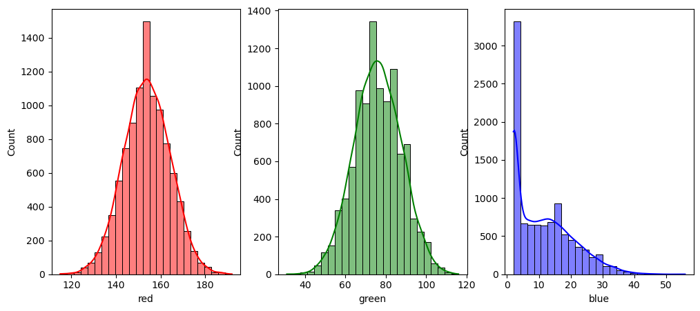

Slide 11
Descriptive statistics
Create dictionary of keys = labels and values = list of statistics
By looping over columns, we can append the calculated stats to its value in the dictionary
Using functions from NumPy library np.mean(),…
Advantage
Instant access to the needed statistic to any column by the column label and the statistic type (mean , median …)

Slide 12
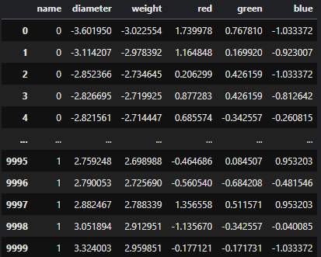
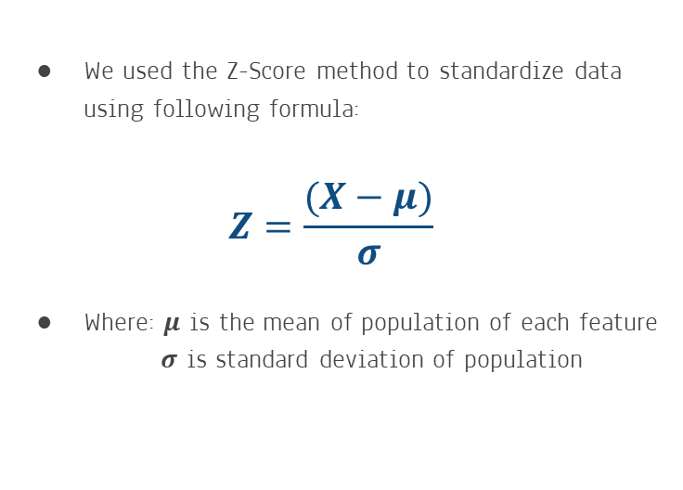
Standardization of data
We used the Z-Score method to standardize data using following formula:
$$Z=\frac{(X−μ)}{σ}$$
Where: 𝝁 is the mean of population of each feature
𝝈 is standard deviation of population
Data after Standardization

Slide 13
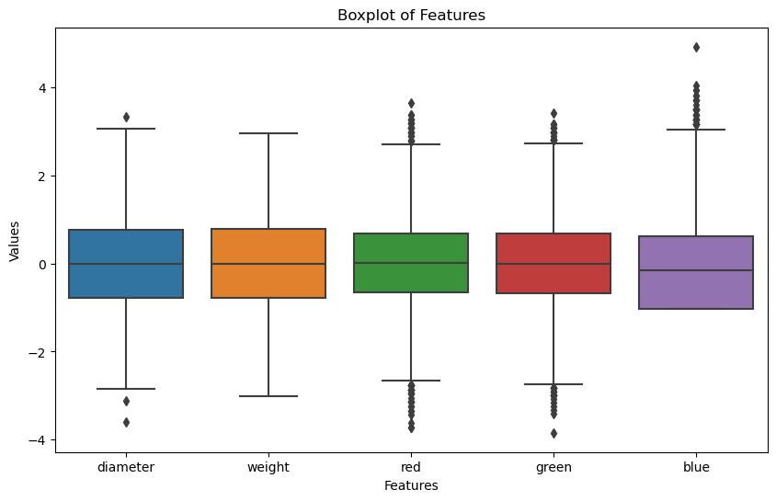
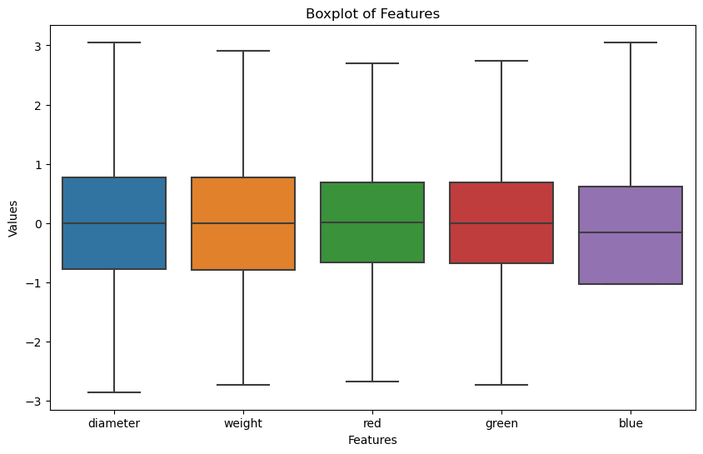
Observing Outliers using Boxplot
Before Removing Outliers
After Removing Outliers

Slide 14
Interquartile Method
75%
Q3 - Q1
25%
=
IQR
Now we have the IQR value , we can use it to define the upper & lower limits of our data (column wise)
Upper = Q3 + 1.5IQR
Lower = Q1 - 1.5IQR

Slide 15

03
HYPOTHESIS TESTING

Slide 16
Testing for Normality
We want a way to test if our features are Normally Distributed or not.
There is two method for testing that, these are Shapiro-Wilk test and Kolmogorov Smirnov test.
We’ll use Shapiro-Wilk test here.

Slide 17
Shapiro-Wilk Test
it superimposes a normal curve over the observed distribution. It then computes which percentage of our sample overlaps with it: a similarity percentage.
The Null Hypothesis (H0): The Data is normally distributed
The Alternative Hypothesis (H0): The Data is not normally distributed
We have to calculate the p-value if p < 0.05 then we reject the Null Hypothesis

Slide 18
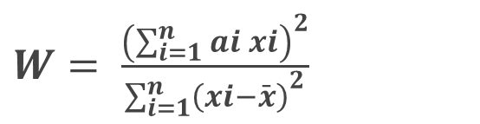
Shapiro-Wilk Test
The Equation for calculating the test statistic in Shapiro-Wilk test:
x: Data being tested
a: Shapiro-Wilk test coefficient
We can get Shapiro-Wilk test coefficient from the Shapiro-Wilk tables for data less than 50
As our Data is much larger than 50 so we have to calculate it
$W= \frac{{\left(\sum_{i=1}^{n}{ai xi}\right)}^{2}}{{\sum_{i=1}^{n}{\left(xi−\bar{x}\right)}}^{2}}$

Slide 19
Shapiro-Wilk Test
Without going deeply inside the equation helped us to calculate the Shapiro-Wilk test coefficient (You can refer to the report for that)
We were able to calculate it then calculate the test statistic (W)
From (W) we could calculate the p-value for each feature.
We also calculated the-value using Shapiro-Wilk test built-in function so we can compare the results

Slide 20
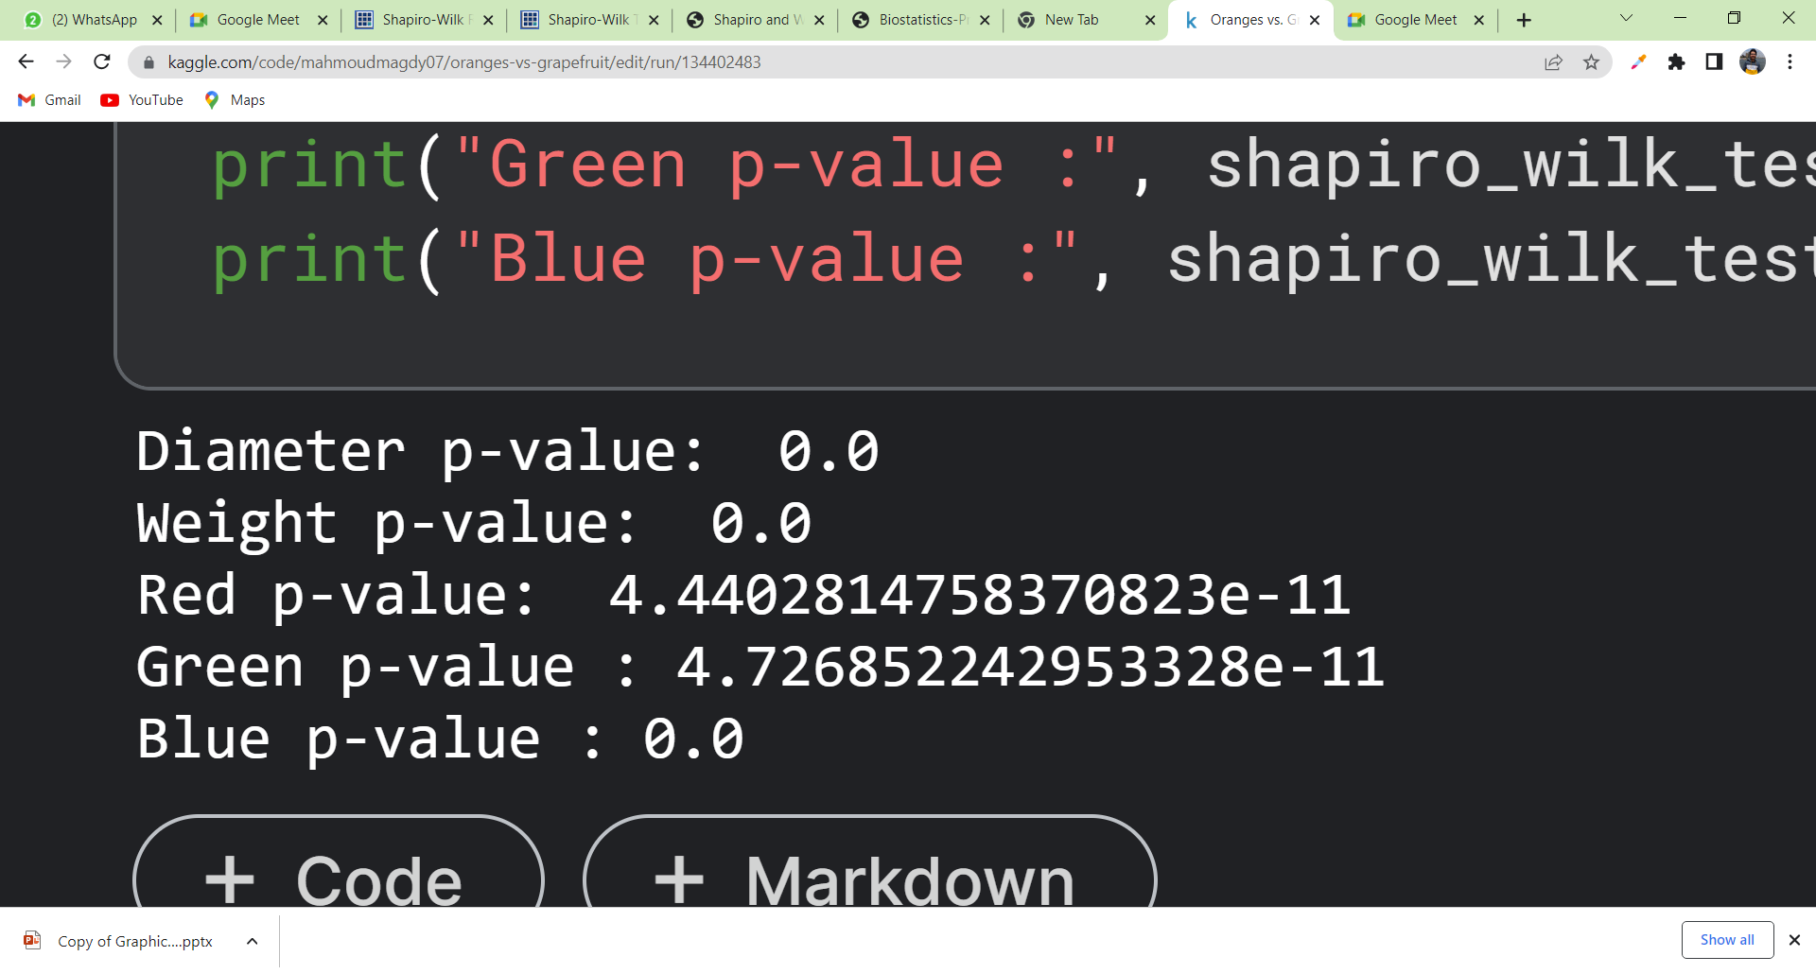
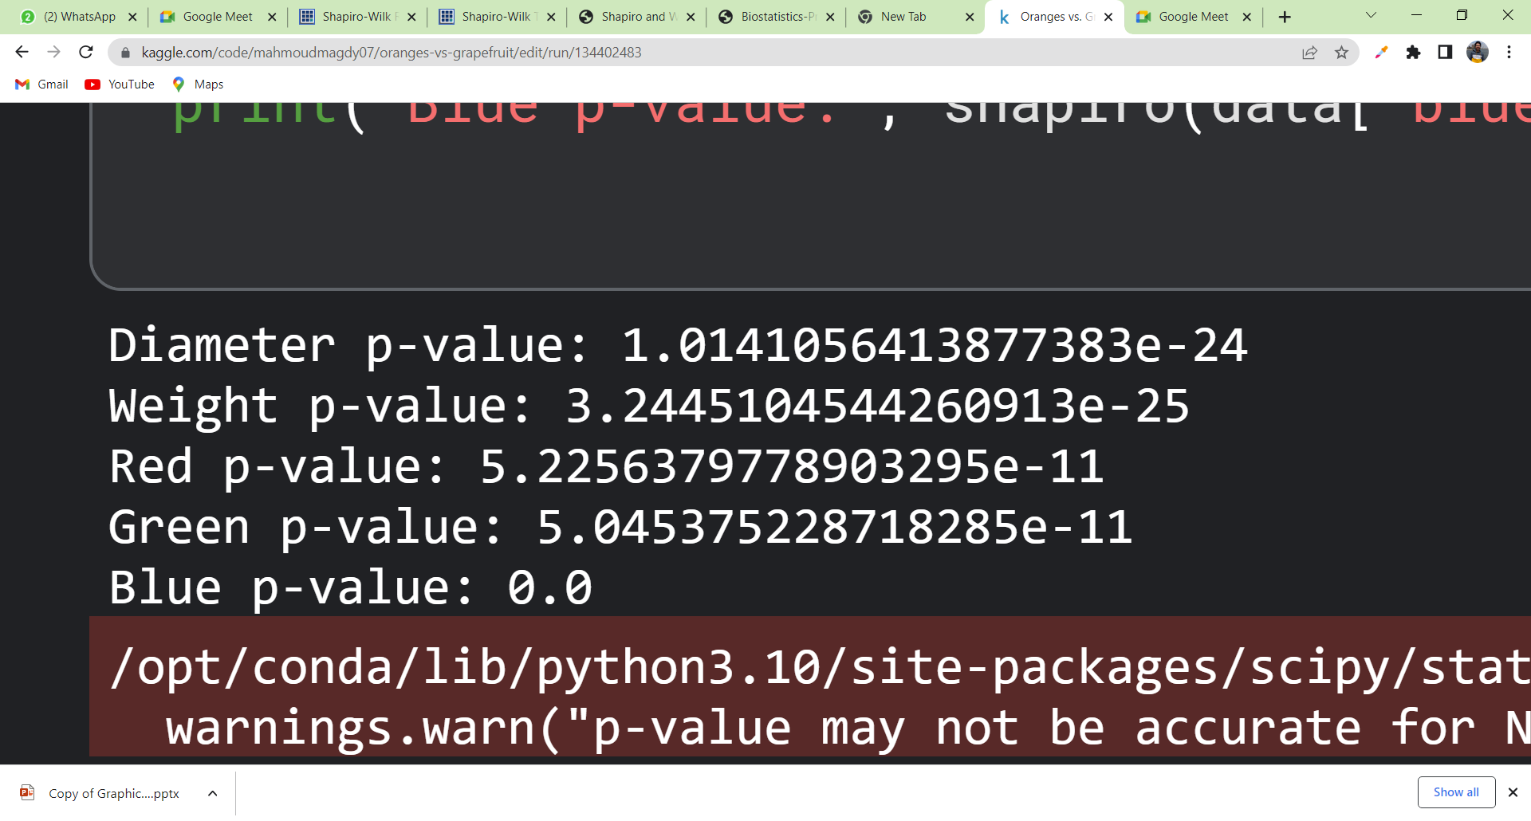
Shapiro-Wilk Test
From scratch function results
Built-in function results
We can clearly see that the results are so close and both of the fuctions indicate that all our features are Not Normally Distribulted

Slide 21

CONDITIONAL DISTRIBUTION
04

Slide 22
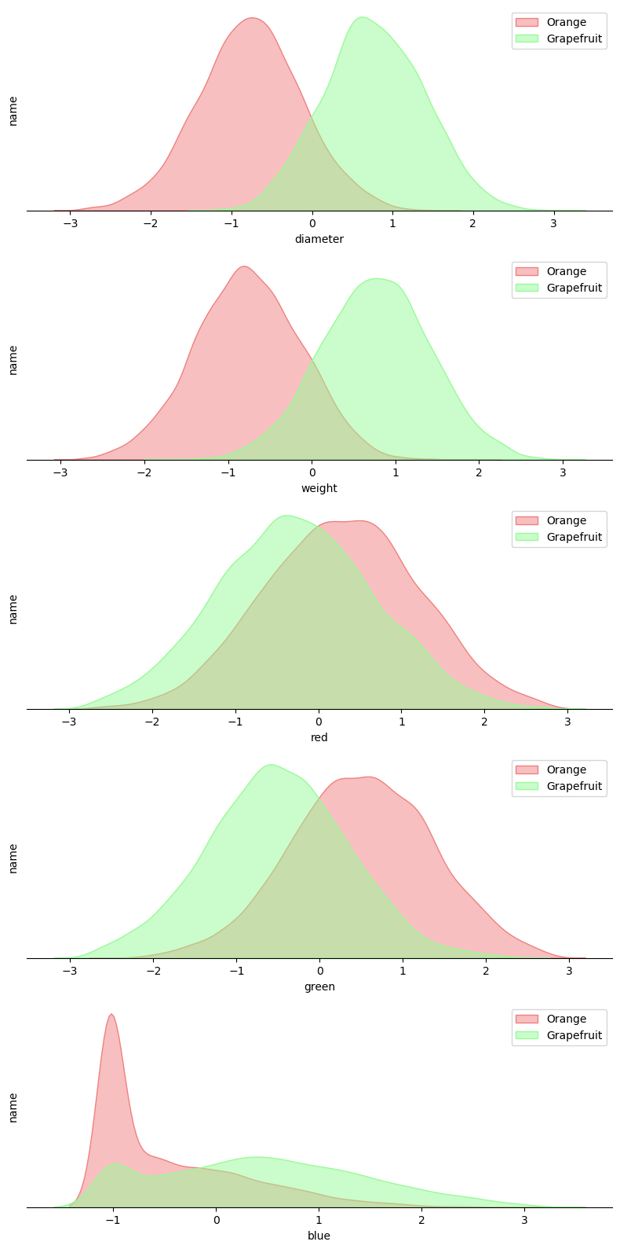
Conditional Distribution
A conditional probability plot displays the relationship between variable while conditioning on a other variable, in our case the feature and the target.
For example:

Slide 23
Conditional Distribution

Slide 24
Conditional Distribution

Slide 25

05
NAÏVE BAYES CLASSIFIER

Slide 26
WHAT is NAÏVE BAYES
1
2
3
Theory
Assumption
Formula
It is based on Bayes' theorem, a fundamental concept in probability theory. allows us to update our beliefs or probabilities based on new evidence.

Slide 27
WHAT is NAÏVE BAYES
2
1
3
Theory
Assumption
Formula
The NB classifier assumes that the features are conditionally independent given the class. This simplifying assumption leads to the term "naïve."

Slide 28
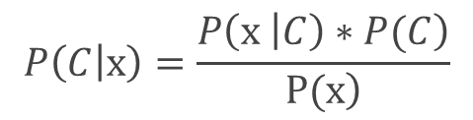
WHAT is NAÏVE BAYES
3
1
2
Theory
Assumption
Formula
Where: C is Target class
x = {x₁, x₂, ... x_{n}} are set of features
P(C) is the prior probability of class C
P(x | C) is the likelihood of observing the features x given class C.
P(x) is the evidence probability

Slide 29
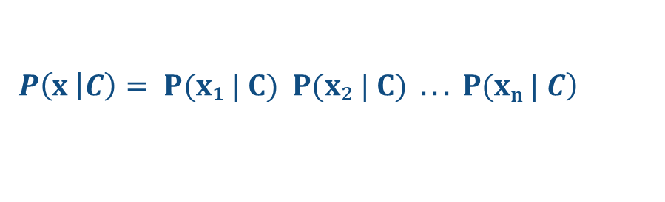
Model Training
From previous assumption of conditional independence among the features given the class. This assumption allows us to factorize the likelihood as:
During the classification phase, the NB classifier calculates the posterior probabilities for each class and selects the class with the highest probability as the predicted class:

Slide 30
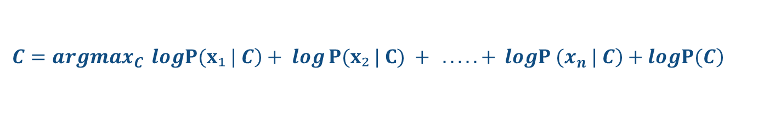
Model Training
Selecting class with highest probability:
Applying the log function to the equation to simplify computation

Slide 31
Model Accuracy
92.40%
92.40%
Naïve Bayes classifier from scratch
Built in Naïve Bayes classifier package

Slide 32

06
SIMPLE NN CLASSIFIER

Slide 33
WHAT is Neural Network
Neural networks, inspired by the structure and functioning of the human brain, consist of interconnected layers of artificial neurons, also known as nodes. These networks learn to extract meaningful patterns and relationships
During training, a neural network adjusts the weights and biases associated
with each connection between neurons to minimize the difference between
its predictions and the true labels
In binary classification tasks, a neural network typically consists of an input
layer, one or more hidden layers, and an output layer.

Slide 34
PROCESS STAGES
Initializing weight and bias tensors with the suitable tensors size
STAGE 01
Forward propagation and
Activation Function
STAGE 02
Prediction error to measure the discrepancy between the predicted output and the actual or target output.
STAGE 03
Backpropagation to compute the gradients of the model's parameters (weights and biases)
STAGE 04
Optimization loop using Gradient descent which is commonly used to train machine learning models
STAGE 05

Slide 35
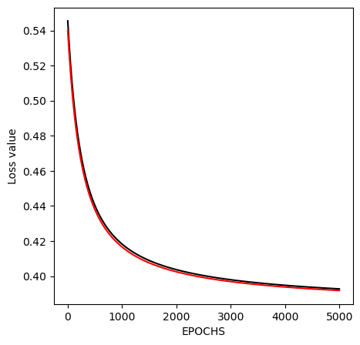
Convergence & model accuracy
During the training process, the loss value is calculated for each iteration or epoch. These loss values is plotted over time to visualize the progress of the optimization process
Upon completing the training process with the previous neural network architecture, we achieved an accuracy of around 92.94%.
This accuracy level is comparable to the accuracy achieved by the model constructed using the Naïve Bayes classifier.

Slide 36

THANKS
Do you have any questions ?

Slide 37
REFERENCES
[1] "Python for Data Analysis" by Wes McKinney - Second Edition
[2] "Exploratory Data Analysis" by John W. Tukey - Reprint Edition
[3] "Practical Statistics for Data Scientists" by Peter Bruce, Andrew Bruce
[4] scribbr: How to Find Outliers [https://www.scribbr.com/statistics/outliers/]
[5] Shapiro, S.S. & Wilk, M.B. (1965), an analysis of variance for normality (complete samples). Biometrika, Vol. 52, No. 3/4.
[6] Royston, J. P. (1992) Approximating the Shapiro-Wilk W-test for non-normality, Statistics and Computing, vol. 2.
[7] "Pattern Classification" by Richard O. Duda, Peter E. Hart, and David G. Stork
[8] "Deep Learning with Python" by François Cholle

